Slide 1
Delegate Report 2022 World Service Conference June 4th, 2022
Cindy Brimmer
Panel 61 “The Legacies live on”
Rhode Island

Slide 3
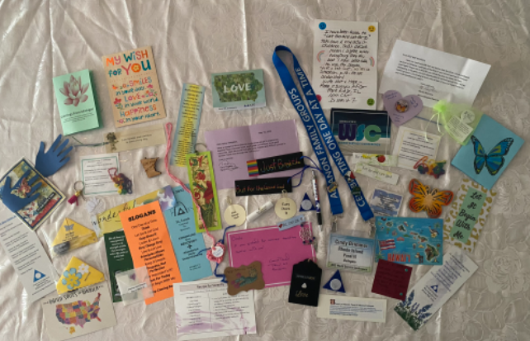
Love and Support from other Delegates!

Slide 4
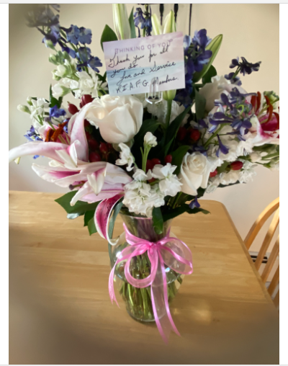
A Gift of Gratitude from the Rhode Island Area!

Slide 5
World Service Conference
April 27-30, 2022
Enhancing our Recovery through Abundance, Unity and Understanding

Slide 6
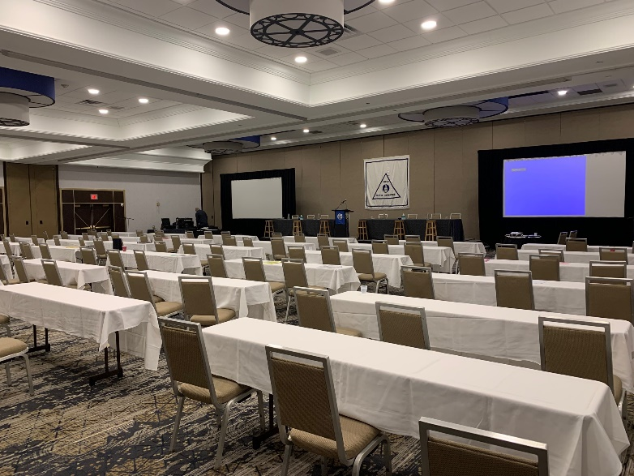
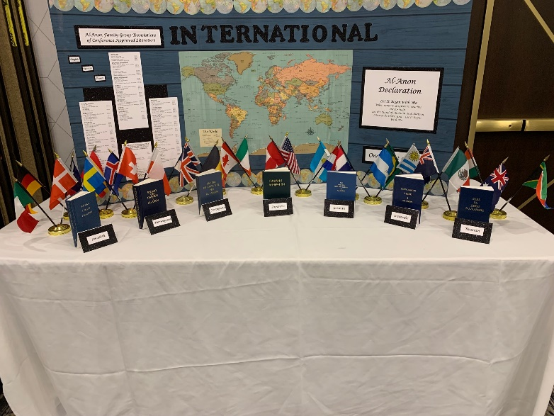
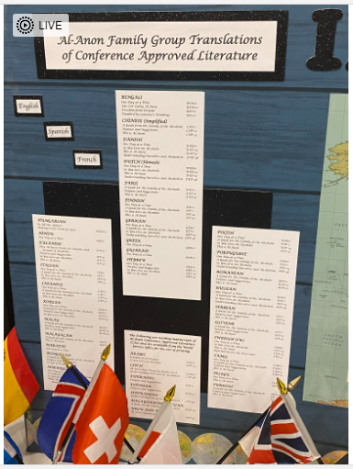
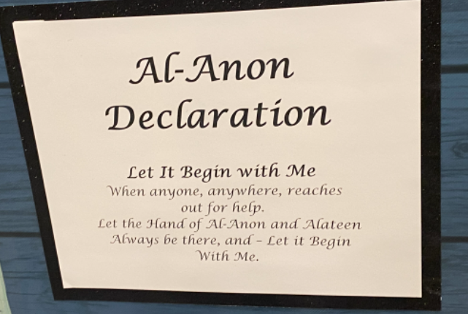
Hello!
Bonjour!
Hola!
UNITY
World Service Conference is a
Trilingual Event:
English
Spanish
French

Slide 7
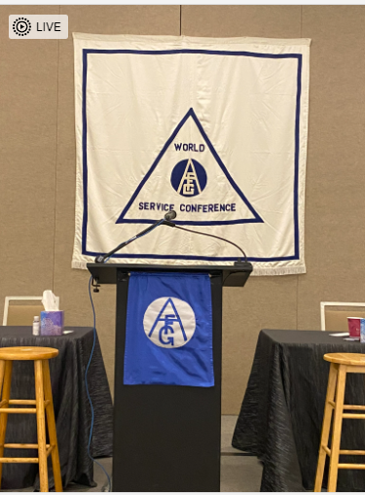
Who Attends World Service Conference
Delegates
Board of Trustees
At Large Members of the Executive Committee
Members of World Service Office (WSO) Staff

Slide 8
World Service Conference Agenda
Motions for Discussion and Voting
Presentations – Audits, Budgets, International, Literature, etc…
Alateen – Recovering after Pandemic
Discussions, Questions and Reflections
Stepping Stones Visit
Al-Anon meetings
Connect to other delegates, board members, and staff
Take away – we were busy!
Meals & Caffination

Slide 9
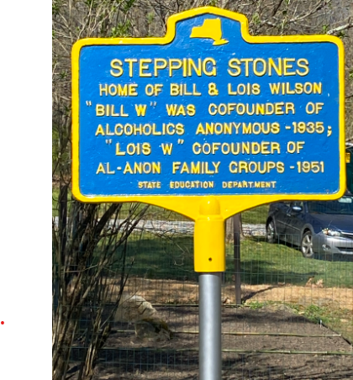
“Lois left everything as it was because she knew you’d be here one day”

Slide 10
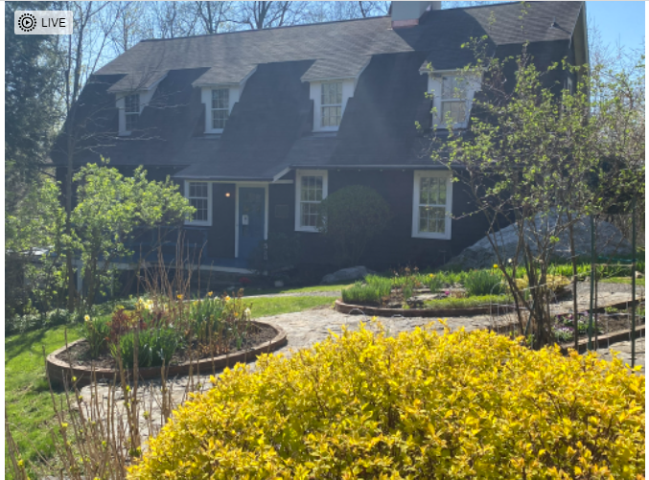
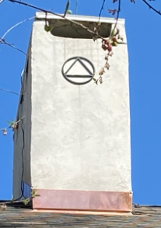
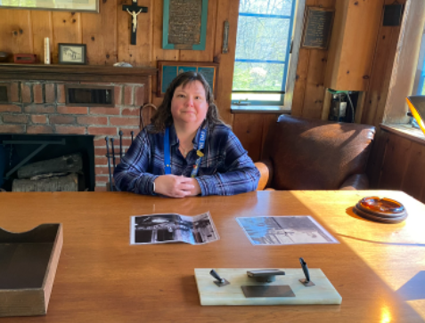
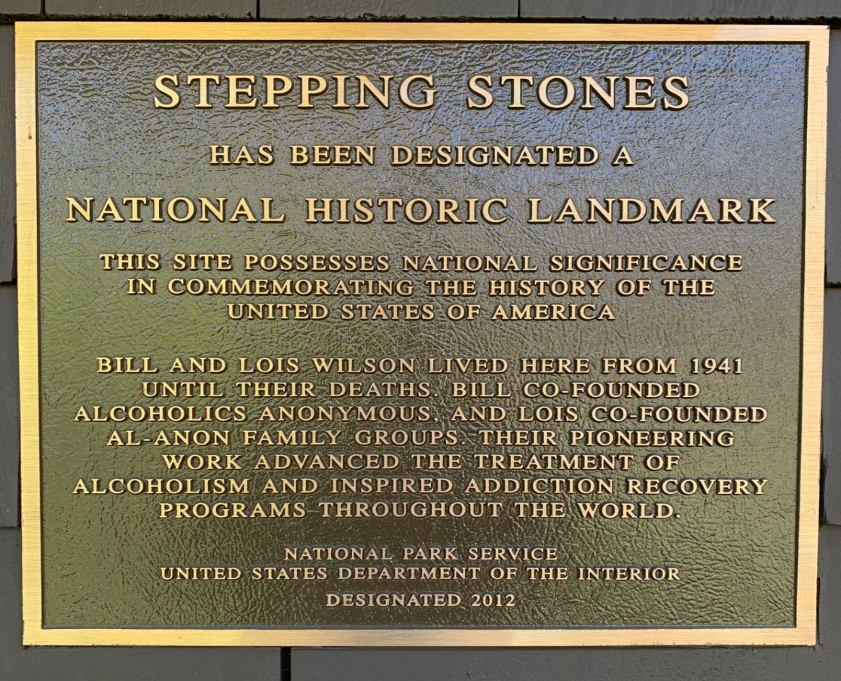
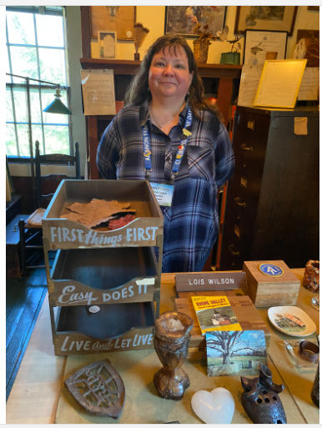
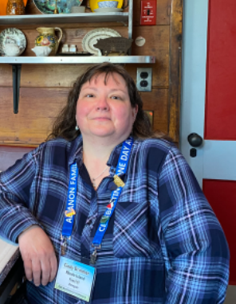

Slide 11
Global Electronic Area
First Motion of the Conference – Passed- Huge Round of Applause!—We Made History!
674 Electronic Groups (March 2022)
We now have Two Kinds of Groups
--- Physical and Electronic
A Group is a Group is a Group—No Longer called Meetings

Slide 12
Global Electronic Area cont.
WSO will register Electronic Groups (still)
A group CAN NOT have a physical location AND
an electronic location
A group can be a physical group with an electronic
component into that physical group (what we think of
as hybrid). That group is part of our Area.
Our mission: If we choose to accept electronic groups
in our Area – notify WSO – Get our procedures in place.

Slide 13
Our New Global Electronic Area (Area 98)
1987 – Last time a new Area was added to our service structure (Alaska).
2022 – We voted to accept Area 98 – Global Electronic Area – to our service structure.
Stats: 162 out of their 217 Group Reps attended the January Assembly where 10 candidates stood for Delegate and Ozzie was elected.
It was a historic and emotional moment following the vote when Ozzie entered the room to a standing ovation.
Now each Area will need to decide if they will also allow Electronic Groups in their service structure.
11 other Areas have voted to accept Electronic Groups into their Area – however – none have completed the work and decisions required to start accepting them formally.
We have NO DEADLINE!
All groups meeting in Rhode Island can stay just as they are until Rhode Island notifies WSO of our decision to allow or not allow Electronic Groups.
Everyone is still “figuring it out”. Some areas have decided not to allow Electronic Groups already and therefore have no work to do.

Slide 14
How WSO has guided Global Electronic Area
2021 WSC voted for electronic Meeting to become groups.
Guide 700+ groups to elect a GR of their group.
Send GR’s to a meeting to elect a Delegate (10 members stood for the position)
Guide the Delegate to hold first ever assembly to elect officers.
Request that the delegate be seated at WSC
Staff updated the service manual to allow areas to no longer be defined geographically.

Slide 15
Groups - Definitions
1. Physical Group: If your group has a physical location as part of its meeting.
In Person
Hybrid
Temporarily Electronic due to pandemic - but expect to return in person/hybrid at some point.
Temporarily Electronic due to pandemic – but UNSURE if group will return to in person again.
2. Electronic Group: If your group does NOT have a physical location as part of its meeting.
Groups that have only ever met electronically.
Groups that used to meet in a physical location but are now electronic and do NOT expect to return to the physical location at all.
As of March 2022 there were 674 of these that had registered with WSO as an electronic group.
Note: Today WSO must register electronic groups but in the future each Area will be able to register a group as either physical or electronic.

Slide 16
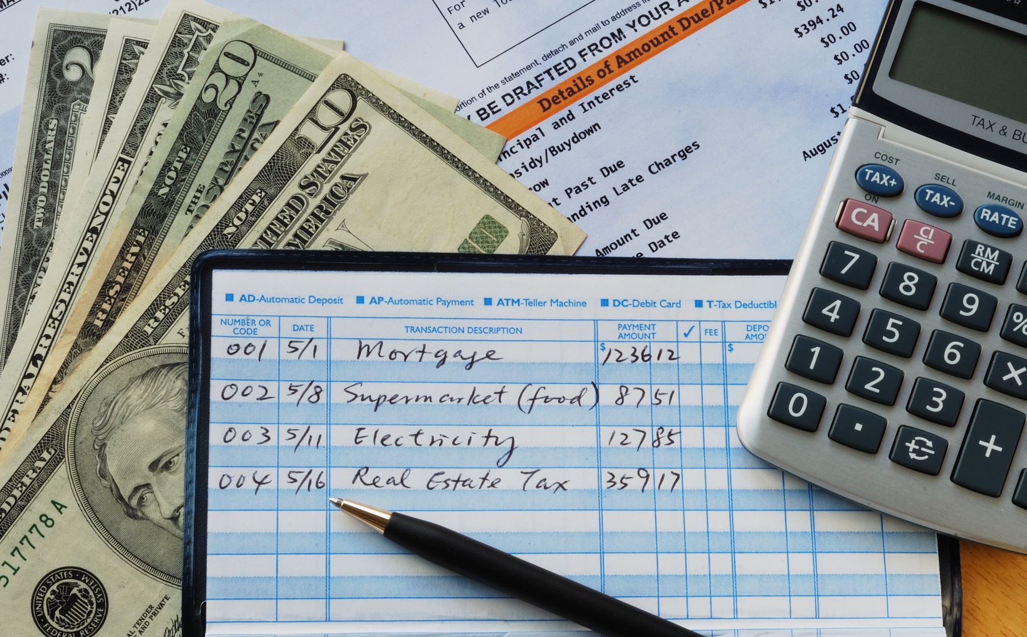
Finances

Slide 17
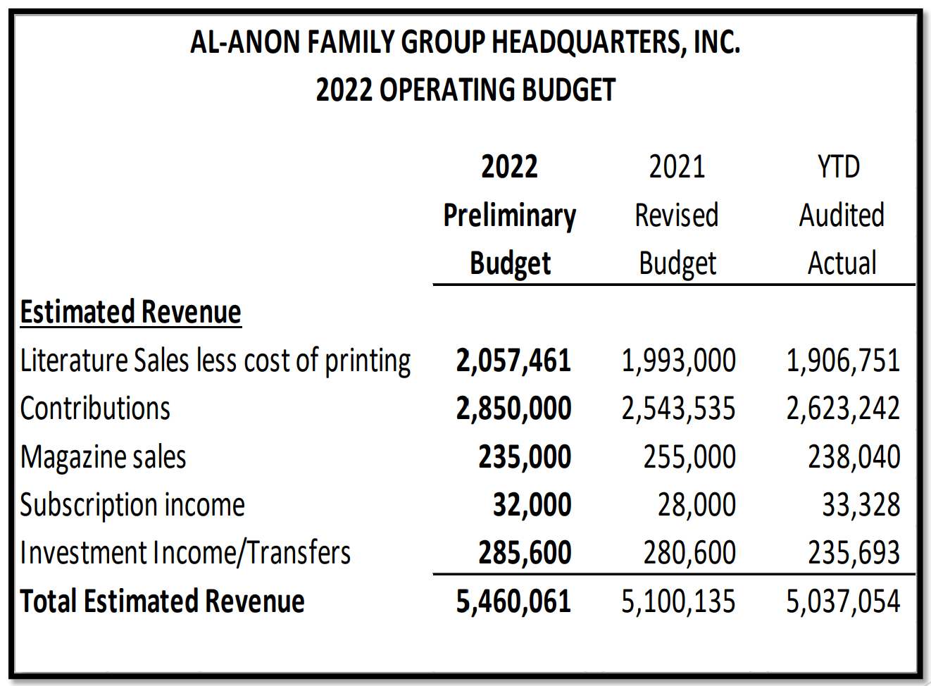
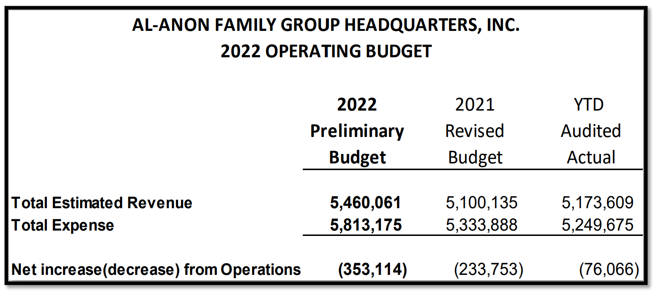
Financial Update
Tradition 7: Self Supporting
Every group ought to be fully self-supporting, declining outside contributions.
Take it back to your groups: WSO needs our contributions.
Ask each member to buy 1 book.
Respond to special appeal that will be coming soon.
Create a budget for your group to ensure self sufficiency
Did you know about Guideline G41 named Reserve Fund. Page 4 covers creating a Group Budget: https://al-anon.org/pdf/G41.pdf

Slide 18
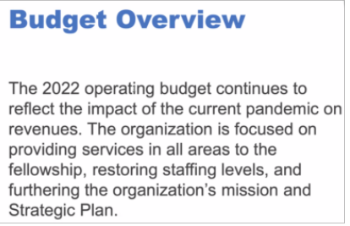

Slide 19
What does the WSO budget provide?
Registering groups
CAL
Mobile app
PSAs
Questions regarding meetings
Questions and concerns
Translating literature
Supporting international structures
Trilingual online store
Forum, Le Lien, en Accion
WSC
Interpretation
Alateen recertification
Protecting Al-Anon name
Website
Updated and translated guidelines
Membership survey
Salaries, building expenses

Slide 20
Major expense categories included in the 2022 Budget
Salaries & associated costs (payroll taxes and benefits)
Office expenses(postage, phone, stationery& supplies, printing, Canadian office)
Occupancy (utilities, maintenance, landscape fees, etc.)
Public Service Announcements (PSAs)
Professional Fees
Travel (in 2020 & up until December 2021, travel was halted)
Conference costs (including interpretation)
Bank & credit card fees

Slide 21
Projects for this year
The new daily reader
“A Little Time for Myself”
New Service Manual published
Electronic group database transformation significant
1st Longitudinal Study
Meet the Board Event in Cleveland in October
IAGSM in London in October
Board Meetings
Hire staff – Associate Director - International

Slide 22
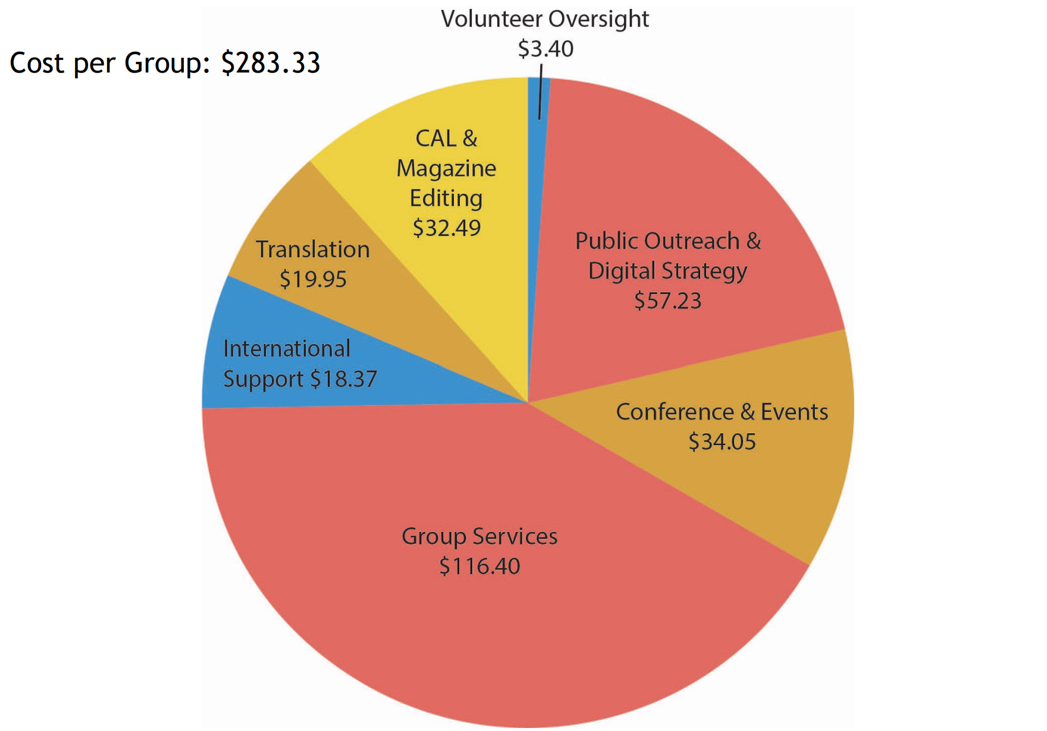
Cost per Group
Tradition 7:
Every group ought to be fully self-supporting, declining outside contributions.
100% of all Al-Anon Family Groups use services (Registration, CAL, PSA, etc…)
But only 52% of all Al-Anon Family Groups Contributed to WSO in 2021 at an average of $174.58 per group.
Stat: Did you know we have 13,841 active groups just in North America?

Slide 24
You can take back to your group
Thank you for your contributions! They are necessary to provide the services WSO offers to groups. “Together we can achieve our primary purpose of helping friends and families.” Cindy M. (Treasurer)
WSO continues to need your contributions as we navigate our way past the pandemic and restoring services impacted by the effects of the pandemic.
Buy a book! Literature sales will increase both WSO and Area finances.
Know that all financial decisions and actions are guided by spiritual principles and the Finance Committee strives to keep all the legacies present in all discussions.

Slide 25
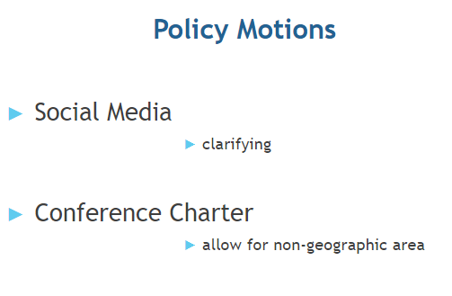

Slide 26
Alateen
Supporting Alateen – Rebuilding After the Pandemic
Electronic groups (Alateen is not part of Global Electronic Area)
Decertification and Re-applying for Alateen
Our Area may want to consider a task force be created to re-evaluate our Area Alateen Safety & Behavior Requirements (ASBRs)

Slide 27
You and Your Board Connect
Cleveland, Ohio Oct 2022
Requesting bids for 2023

Slide 28
2023 Al-Anon International Convention
Albuquerque, NM
June 29-July 2, 2023
New Hopes, New Friends, Renewed Recovery

Slide 29
Miscellaneous But Important to Know
Al-Anon Membership Survey Summary: https://al-anon.org/pdf/2021-MembershipSurvey.pdf
Longitudinal Survey Starts this Year – 5-10 year program – option on 2021 Survey.
Next Al-Anon International Convention is June 29-July 2 2023 in Albuquerque, NM – Open to All Members of Al-Anon
Registration opens in January 2023
Road Trip in 2022: October 29th in Cleveland, Ohio – Meet Board of Trustees at 2022’s Road Trip
If we wanted to apply to host the 2023 Road Trip we would need to do so by September 23rd.
Over 100 writing submissions from our Alateens for the bookmark that is being compiled now.
46 Employees Work at Al-Anon Headquarters, Inc in Virginia Beach, VA
They are hiring an Al-Anon member with 6-8 years in the program who has served beyond the group level to lead International Programs to replace Marsha, who is retiring.
2022-2025 Al-Anon/Alateen Service Manual is OUT electronically: https://al-anon.org/for-members/members-resources/manuals-and-guidelines/service-manual/
Al-Anon Annual Report will be available on WSO website soon.

Slide 30
Thank You for Allowing Me
to Be Your Trusted Servant.
Love in Service,
Cindy Brimmer
Delegate.riafg@gmail.com
401-465-5398

